Slide 1

Lecture 12
DOM

Slide 2

Agenda
HTML DOM Introduction
HTML DOM Node
HTML DOM Function
HTML DOM Access
HTML DOM Modify
HTML DOM Event
HTML DOM Summary

Slide 3


What is the HTML DOM?
The HTML DOM is an Object Model for HTML. It defines:
HTML elements as objects
Properties for all HTML elements
Methods for all HTML elements
Events for all HTML elements

Slide 4

What is the HTML DOM?
The HTML DOM is an API (Programming Interface) for JavaScript:
JavaScript can add/change/remove HTML elements
JavaScript can add/change/remove HTML attributes
JavaScript can add/change/remove CSS styles
JavaScript can react to HTML events
JavaScript can add/change/remove HTML events

Slide 5
HTML Dom Node
According to W3C's HTML DOM standard, all content in an HTML document is nodes:
The entire document is a document node
Each HTML element is an element node
The text within HTML elements is a text node
Each HTML attribute is a property node
Annotations are annotation nodes

Slide 6
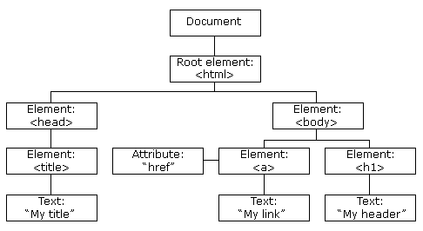
HTML DOM Node?
When a web page is loaded, the browser creates a Document Object Model of the page.
HTML DOM model is constructed as a tree of Objects:

Slide 7
HTML DOM Node?
The nodes in the node tree have hierarchical relationships with each other.
In the node tree, the top node is called the root.
Each node has a parent node, except for the root (which has no parent node).
A node can have any number of child nodes.
Siblings are nodes with the same parent node.

Slide 8
HTML DOM Node
HTML EXAMPLE
From the HTML on the left:
<html>Node has no parent node; It is the root node
The parent node of<head>and<body>is the<HTML>node
The parent node of the text node "Hello world!" is the<p>node
<html>The node has two child nodes:<head>and<body>
The<head>node has two child nodes:<meta>and<title>nodes
The node also has a child node: the text node "DOM Tutorial“
<h1>The<p>node is a sibling node and also a child node of the<body>
<html>
<head>
<meta charset="utf-8">
<title>DOM Node</title>
</head>
<body>
<h1>DOM Node1</h1>
<p>Hello world!</p>
</body>
</html>

Slide 9
HTML DOM Function
The HTML DOM method is an action that we can execute on a node (HTML element).
The HTML DOM attribute is a value that we can set and modify in nodes (HTML elements).
HTML DOM can be accessed through JavaScript (as well as other programming languages).
All HTML elements are defined as objects, while programming interfaces are object methods and object properties.
A method is an action that you can perform (such as adding or modifying elements).
Properties are values that you can obtain or set (such as the name or content of a node)

Slide 10
HTML DOM Function
Some commonly used HTML DOM methods::
GetElementById (id) - Get the node (element) with the specified id
AppendChild (node) - Insert a new child node (element)
RemoveChild (node) - Remove child nodes (elements)
Some commonly used HTML DOM attributes:
InnerHTML - Text value of node (element)
ParentNode - The parent node of a node (element)
ChildNodes - Child nodes of nodes (elements)
Attributes - Attribute nodes of nodes (elements)

Slide 11
HTML DOM Access
When you want to access HTML elements with JavaScript, you have to find the elements first.
There are a couple of ways to do this:
Finding HTML elements by id
Finding HTML elements by tag name
Finding HTML elements by class name
Finding HTML elements by CSS selectors

Slide 12
Finding HTML Element by Id
The easiest way to find an HTML element in the DOM, is by using the element id.
This example finds the element with id="intro":
Example：
var myElement = document.getElementById("intro");
If the element is found, the method will return the element as an object (in myElement).
If the element is not found, myElement will contain null.

Slide 13
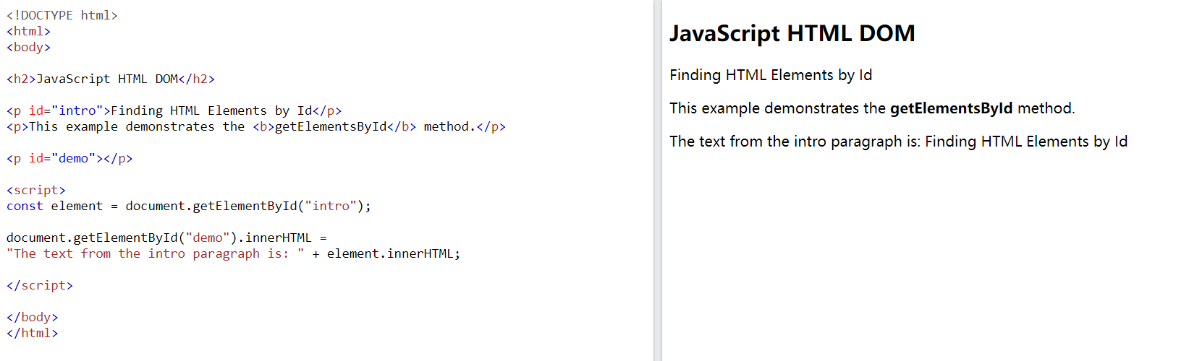
Finding HTML Element by Id

Slide 14
Finding HTML Elements by Tag Name
This example finds all <p> elements:
Example：
var x = document.getElementsByTagName("p");
This example finds the element with id="main", and then finds all <p> elements inside "main":
Example：
var x = document.getElementById("main");
var y = x.getElementsByTagName("p");

Slide 15
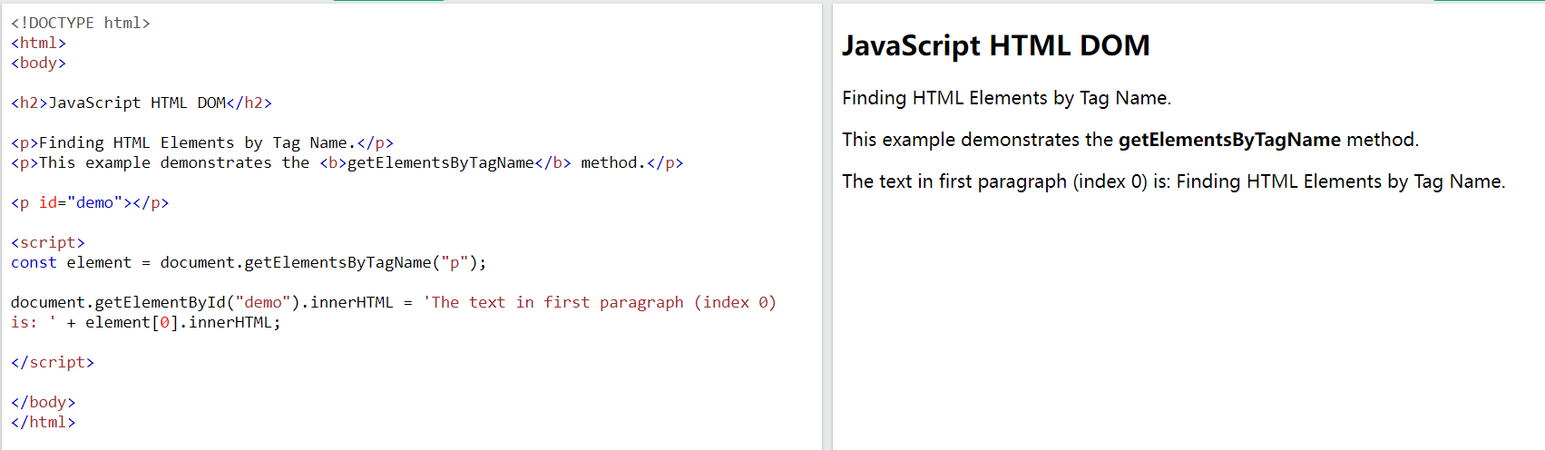
Finding HTML Element by Tag Name
Example

Slide 16
Finding HTML Elements by Class Name
If you want to find all HTML elements with the same class name, use getElementsByClassName().
This example returns a list of all elements with class="intro".
Example：
var x = document.getElementsByClassName("intro");

Slide 17
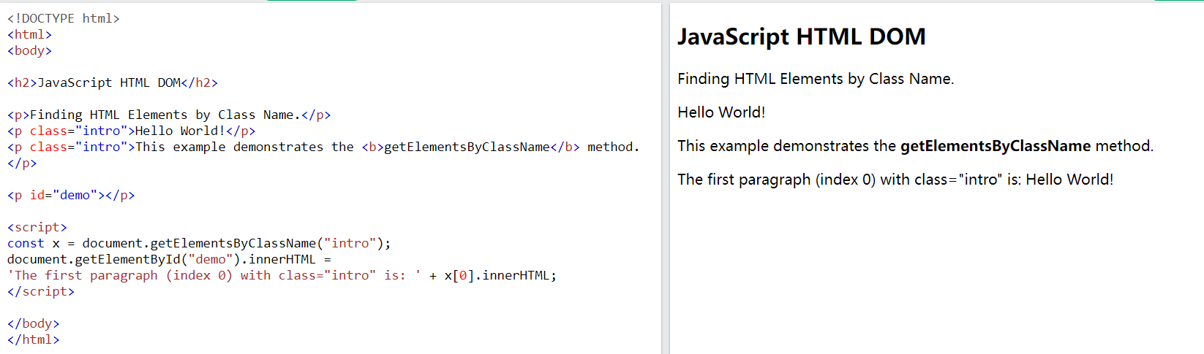
Finding HTML Element by Class Name
Example

Slide 18
Finding HTML Elements by CSS Selectors
If you want to find all HTML elements that matches a specified CSS selector (id, class names, types, attributes, values of attributes, etc), use the querySelectorAll() method.
This example returns a list of all <p> elements with class="intro"
var x = document.querySelectorAll("p.intro");

Slide 19
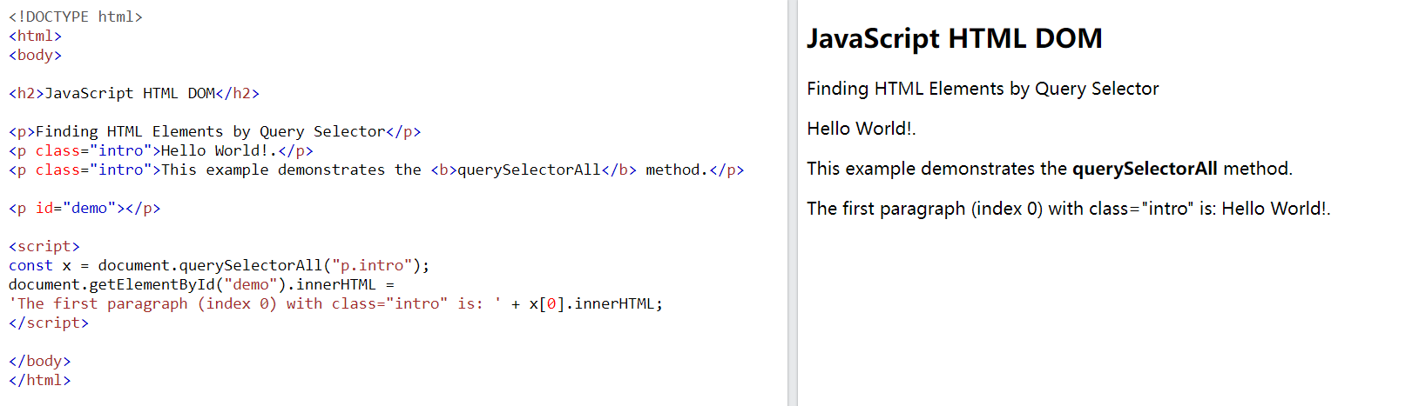
Finding HTML Element by CSS Selectors
Example

Slide 20
HTML DOM Modify
Modifying HTML means changing elements, attributes, styles, and events.
Modifying the HTML DOM means many different aspects::
Change HTML content
Change CSS style
Change HTML properties
Create new HTML elements
Delete existing HTML elements
Change event (handler)

Slide 21
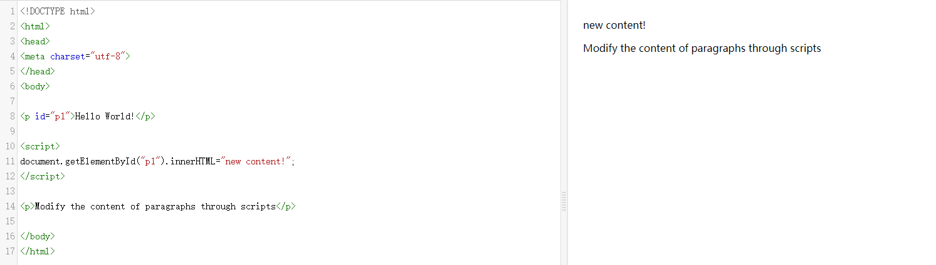
Create HTML Content

Slide 22
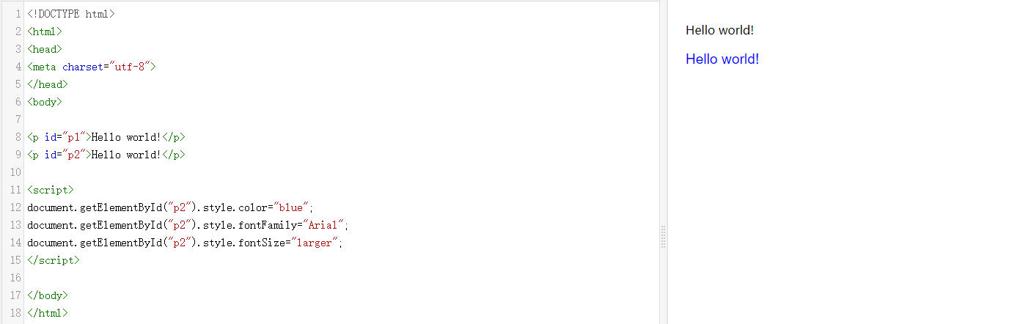
Change HTML Style

Slide 23
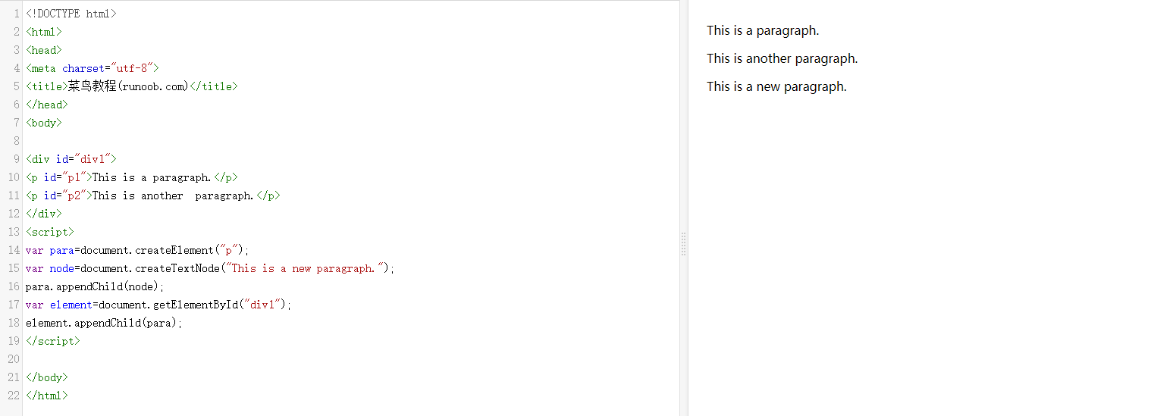
Create new HTML elements

Slide 24
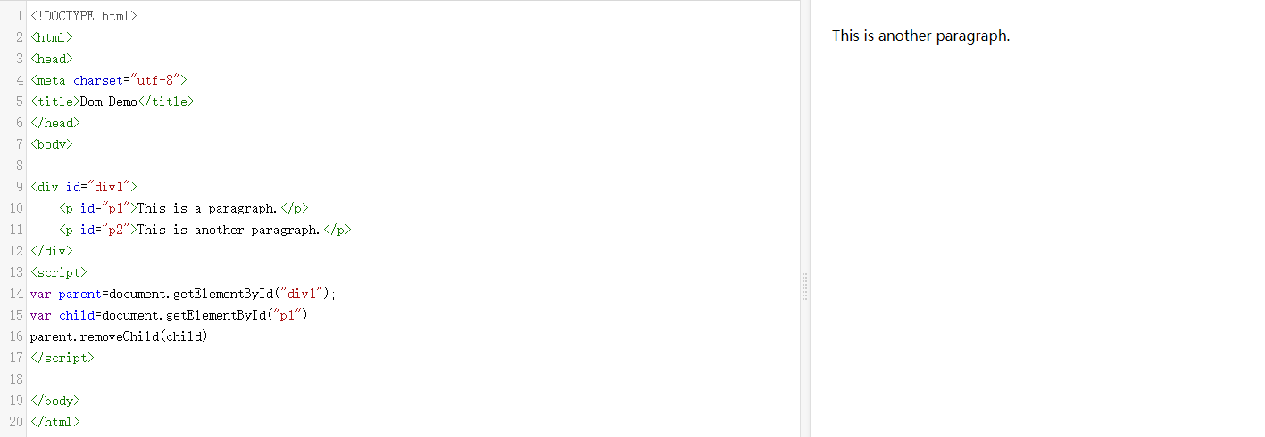
Delete existing HTML elements

Slide 25
HTML DOM Event
HTML DOM allows JavaScript to react to HTML events. When an event occurs, JavaScript can be executed, such as when a user clicks on an HTML element.
When the user clicks the mouse
When the webpage is loaded
When the image is already loaded
When the mouse moves over an element
When the input field is changed
When an HTML form is submitted
When the user triggers a button

Slide 26
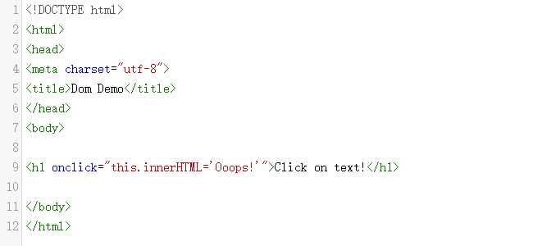


HTML DOM Event
When the user clicks the mouse

Slide 27
HTML DOM Event
When the user enters or leaves the page, the onload and onload events are triggered.
The onload event can be used to check the browser type and version of visitors, in order to load different versions of web pages based on this information.
The onload and onload events can be used to handle cookies.
onchange Events are commonly used for validating input fields
The onmouseover and onmouseout events can be used to trigger functions when the mouse pointer moves to or from an element.

Slide 28
HTML DOM Summary
This chapter has already explained how to use HTML DOM to enhance the dynamic interactivity of a website.
You have learned how to manipulate HTML elements to respond to different scenarios.

